Slide 1
Beyond basics –L2
Assembly Language Programming
Dr Emmanuel Ahene

Slide 2
PARITY
The fundamental unit of computer storage is a bit; it could be on (1) or off (0). A group of eight bits makes a byte. Seven bits are used for data and the last one is used for parity. According to the rule of parity, number of bits that are on (1) in each byte should always be odd

Slide 3
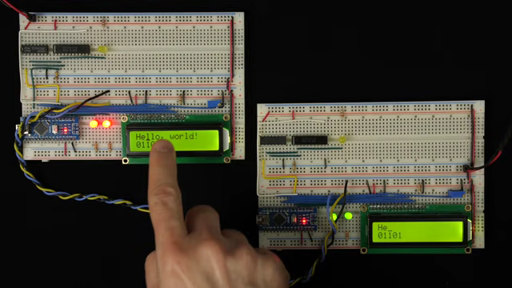
DUMMY DEMO

Slide 4
So the parity bit is used to make the number of bits in a byte odd. If the parity is even, the system assumes that there had been a parity error (though rare) which might have caused due to hardware fault or electrical disturbance.
The processor supports the following data sizes:
Word: a 2-byte data item
Doubleword: a 4-byte (32 bit) data item
Quadword: an 8-byte (64 bit) data item
Paragraph: a 16-byte (128 bit) area
Quadword: an 8-byte (64 bit) data item
Paragraph: a 16-byte (128 bit) area

Slide 5
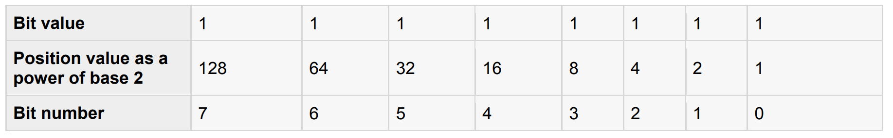
The Binary Number System
Every number system uses positional notation i.e., each position in which a digit is written has a different positional value. Each position is power of the base, which is 2 for binary number system, and these powers begin at 0 and increase by 1

Slide 6
The value of a binary number is based on the presence of 1 bits and their positional value. So the value of the given binary number is: 1 + 2 + 4 + 8 +16 + 32 + 64 + 128 = 255, which is same as 2 - 1.
8

Slide 7
The Hexadecimal Number System
Hexadecimal number system uses base 16. The digits range from 0 to 15. By convention, the letters A through F is used to represent the hexadecimal digits corresponding to decimal values 10 through 15.
Main use of hexadecimal numbers in computing is for abbreviating lengthy binary representations. Basically hexadecimal number system represents a binary data by dividing each byte in half and expressing the value of each half-byte. The following table provides the decimal, binary and hexadecimal equivalents:

Slide 8
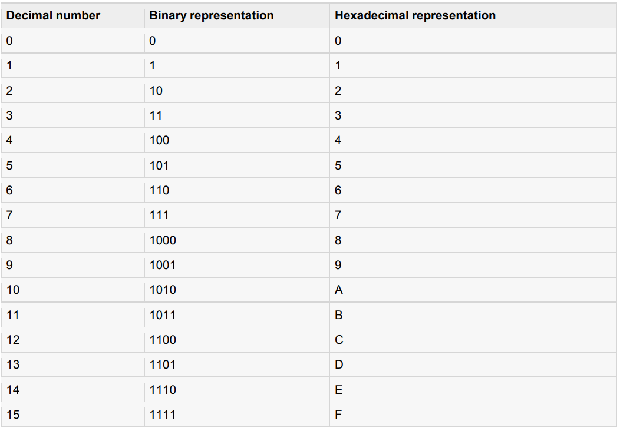
Check ASCII CHART
http://www.aboutmyip.com/AboutMyXApp/AsciiChart.jsp

Slide 9
To convert a binary number to its hexadecimal equivalent, break it into groups of 4 consecutive groups each, starting from the right, and write those groups over the corresponding digits of the hexadecimal number.
Example: Binary number 1000 1100 1101 0001 is equivalent to hexadecimal - 8CD1
To convert a hexadecimal number to binary just write each hexadecimal digit into its 4-digit binary equivalent.
Example: Hexadecimal number FAD8 is equivalent to binary - 1111 1010 1101 1000

Slide 10
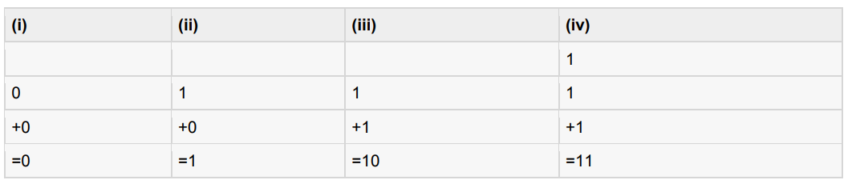
BINARY ARITHMETIC
The following table illustrates four simple rules for binary addition:
Rules (iii) and (iv) shows a carry of a 1-bit into the next left position.

Slide 11
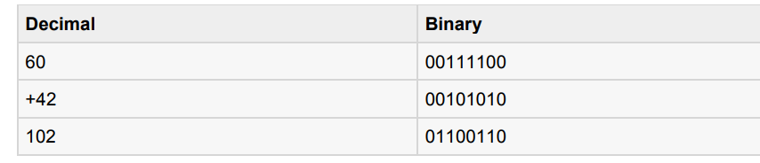
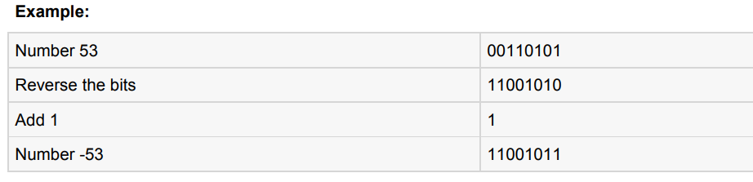
A negative binary value is expressed in two's complement notation. According to this rule, to convert a binary number to its negative value is to reverse its bit values and add 1

Slide 12
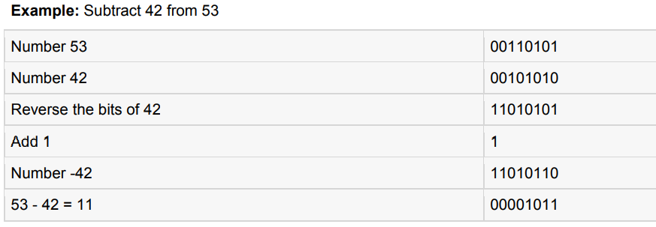
To subtract one value from another, convert the number being subtracted to two's complement format and add the numbers.
Overflow of the last 1 bit is lost.

Slide 13
Addressing Data in Memory
The process through which the processor controls the execution of instructions is referred as the fetch-decode execute cycle, or the execution cycle. It consists of three continuous steps:
Fetching the instruction from memory
Decoding or identifying the instruction
Executing the instruction

Slide 14
The processor may access one or more bytes of memory at a time. Let us consider a hexadecimal number 0725H.
This number will require two bytes of memory.
The high-order byte or most significant byte is 07 and the low order byte is 25.
The processor stores data in reverse-byte sequence i.e., the low-order byte is stored in low memory address and high-order byte in high memory address.
So if processor brings the value 0725H from register to memory, it will transfer 25 first to the lower memory address and 07 to the next memory address.

Slide 15
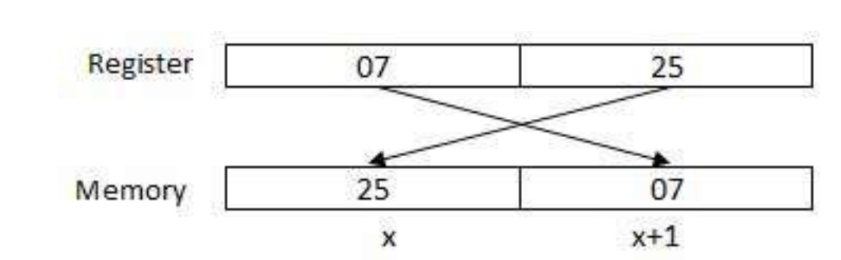
x: memory address

Slide 16
When the processor gets the numeric data from memory to register, it again reverses the bytes.
There are two kinds of memory addresses:
An absolute address - a direct reference of specific location.
The segment address (or offset) - starting address of a memory segment with the offset value
an offset usually denotes the number of address locations added to a base address in order to get to a specific absolute address.

Slide 17
Assembly Basic Syntax
An assembly program can be divided into three sections:
The data section
The bss section
The text section

Slide 18
The data Section
The data section is used for declaring initialized data or constants. This data does not change at runtime.
You can declare various constant values, file names or buffer size etc. in this section.
The syntax for declaring data section is:
section .dat

Slide 19
The bss Section
The bss section is used for declaring variables. The syntax for declaring bss section is:
section .bss

Slide 20
The text section
The text section is used for keeping the actual code.
This section must begin with the declaration global main, which tells the kernel where the program execution begins.
The syntax for declaring text section is:
section .text
global main
main:

Slide 21
Comments
Assembly language comment begins with a semicolon (;). It may contain any printable character including blank. It can appear on a line by itself, like:
; This program displays a message on screen
or, on the same line along with an instruction, like:
add eax ,ebx ; adds ebx to eax

Slide 22
Assembly Language Statements
Assembly language programs consist of three types of statements:
Executable instructions or instructions
Assembler directives or pseudo-ops
Macros

Slide 23
The executable instructions or simply instructions tell the processor what to do.
Each instruction consists of an operation code (opcode). Each executable instruction generates one machine language instruction.
The assembler directives or pseudo-ops tell the assembler about the various aspects of the assembly process. These are non-executable and do not generate machine language instructions.
Macros are basically a text substitution mechanism.

Slide 24
Syntax of Assembly Language Statements
Assembly language statements are entered one statement per line. Each statement follows the following format:
[label] mnemonic [operands] [;comment]
The fields in the square brackets are optional. A basic instruction has two parts, the first one is the name of the instruction (or the mnemonic) which is to be executed, and the second are the operands or the parameters of the command.

Slide 25
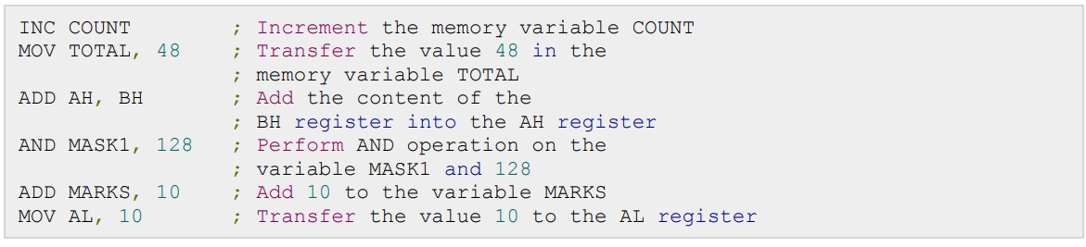
Following are some examples of typical assembly language statements:

Slide 26
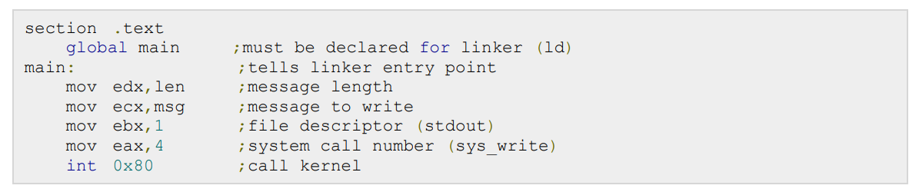
The Hello World Program in Assembly
The following assembly language code displays the string 'Hello World' on the screen:

Slide 27
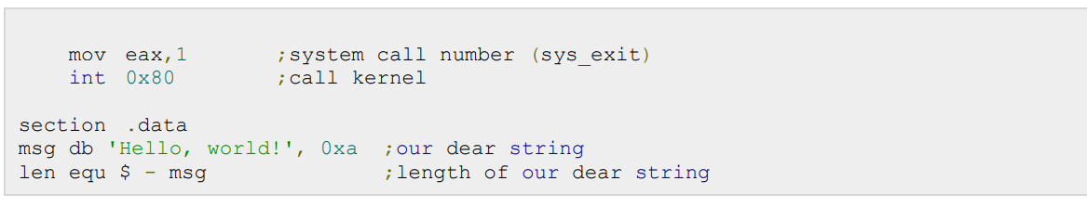
When the above code is compiled and executed, it produces following result:

Slide 28
Compiling and Linking an Assembly Program in NASM
Make sure you have set the path of nasm and ld binaries in your PATH environment variable. Now take the following steps for compiling and linking the above program:
Type the above code using a text editor and save it as hello.asm. • Make sure that you are in the same directory as where you saved hello.asm.

Slide 29
To assemble the program, type nasm -f elf hello.asm
If there is any error, you will be prompted about that at this stage. Otherwise an object file of your program named hello.o will be created.
To link the object file and create an executable file named hello, type
ld -m elf_i386 -s -o hello hello.o
Execute the program by typing ./hello
If you have done everything correctly, it will display Hello, world! on the screen

